Slide 1


PORTFOLIO
SNEHA KATOLE

Slide 2
Professional Background
I am Sneha Katole, currently pursuing a Bachelor of Technology at Vishwakarma Institute of Technology, Pune, with an expected graduation in 2027. I have maintained a strong academic record with a current CGPA of 8.71.
My professional interests lie in the fields of:
Data Analysis & Visualization
Data Science & Machine Learning
Relational Databases (MySQL)
Excel-based Statistical Modeling
I am deeply passionate about turning raw data into meaningful insights that drive smarter decisions. I have developed hands-on projects that demonstrate the application of analytical thinking, from identifying customer behavior patterns to optimizing operations through data-driven planning.
In addition to my technical skills, I bring strong adaptability, curiosity, and a collaborative spirit. I enjoy exploring new tools, frameworks, and approaches to solve challenging problems. I am particularly interested in domains like customer experience analytics, business intelligence, and operations research.
I aspire to grow as a data professional who not only understands the tools but also the why behind the data — using analytics to bridge the gap between information and impact.

Slide 3
Table of Contents
S.No. | Project Title | Page no.
1 | Professional BAckground | 2
2 | Table of Contents | 3
3 | What is Data Analytics | 4
4 | Data Analytics Process | 5-6
5 | Instagram User Analytics | 7-12
6 | Operation Analytics with Metric Spike | 13-22
7 | Hiring Process Analysis | 23-26
8 | IMDb Movie Analysis | 27-33
9 | Bank Loan Case Study | 34-40
10 | Car Features Analysis | 41-44
11 | ABC CAll Volume Trend Analysis | 45-49

Slide 4
What is Data Analytics
Data analytics is the process of examining, organizing, and interpreting raw data to uncover meaningful patterns, trends, and insights. It involves the use of statistical techniques, programming tools, and visualization methods to support decision-making, optimize operations, and solve business problems. By transforming complex datasets into actionable information, data analytics empowers organizations to make informed choices, predict future outcomes, and gain a competitive advantage in today’s data-driven world.
As businesses continue to generate vast amounts of data through digital interactions, the demand for skilled data analysts has grown rapidly. From improving customer experience to enhancing operational efficiency, data analytics plays a vital role across industries such as finance, healthcare, marketing, and technology. Whether through descriptive dashboards or predictive models, data analysts bridge the gap between raw information and strategic decision-making, turning data into a powerful asset for innovation and growth.

Slide 5
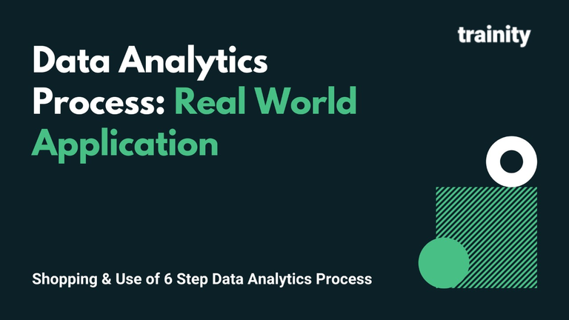
Data Analytics Process
Module- I
Description:
We use Data Analytics in everyday life without even knowing it.
For eg : Going to a market to buy something .
Plan: We first decide which things I need before going to market . Is it a shirt , jeans , footwear etc.
Prepare: Next I need to check how much I am willing to spend and how to get that money.
Process: Then I need to check how much I want from the data. Like if I am going to buy footwear what do I want - slippers / shoes / sandals etc.
Analyze: You obviously won't buy things which are out of trend, Also you need to check does the jeans which you have and the color of t-shirt you want to buy, will it make a good combination.
Share: Now you communicate your idea to the shopkeeper to find the best suitable fit for you.
Act: Then you finally buy it!
t

Slide 6
Task:
Your task is to give the example(s) of such a real-life situation where we use Data Analytics and link it with the data analytics process. You can prepare a PPT/PDF on a real-life scenario explaining it with the above process (Plan, Prepare, Process, Analyze, Share, Act) and submit it as part of this task.
Case Study: Understanding the aƩendance trends for a school
1. Plan: first understanding which parameters are affecƟng the attendance records. For example, the grades of the student, health condition of a student, weather, etc.
2. Prepare: next get the data regarding the attendance records from the school for a sample of students.
3. Process: cleaning the missing records, removing the errors (where student present has been marked absent or vice versa cause of manual errors during attendance filling by the teacher).
4. Analyse: understand the co-relation of different factors discussed in the planning stage with the attendance trends and how they’re affecting the attendance of students.
5. Share: Communicate the insights gained to the school, with the parents of the student with low attendance record and discussing the reason accordingly.
6. Act: Then take actions regarding what could be done to reduce the low attendance.

Slide 7
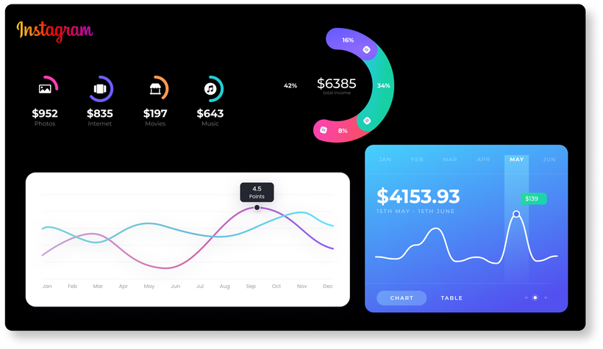
Instagram User Analytics
Module- II
Project Description
This project focuses on analysing Instagram user interactions and engagement using MySQL Workbench. The goal is to extract meaningful insights that support the product and marketing teams in making informed decisions about user retention, campaign strategies, and platform improvements.
Approach
1. Explored the database structure, including tables like users, photos, likes, tags, photo_tags, comments, and follows.
2. Created SQL queries to answer the given tasks.
3. Analysed outputs to derive actionable insights as asked.
4. Compiled queries, outputs, and conclusions in a structured report.
Tech-Stack Used
1. MySQL Workbench: Used for writing and executing SQL queries.
2. SQL: Structured Query Language for data extraction and analysis.

Slide 8
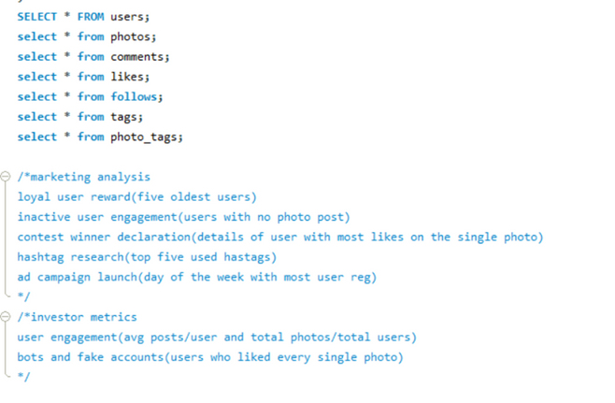
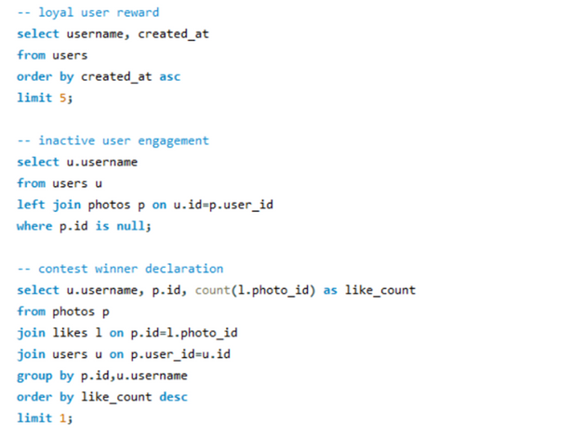
Queries and Outputs
Marketing Analysis

Slide 9
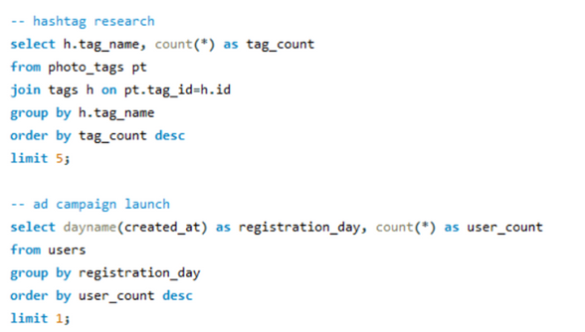
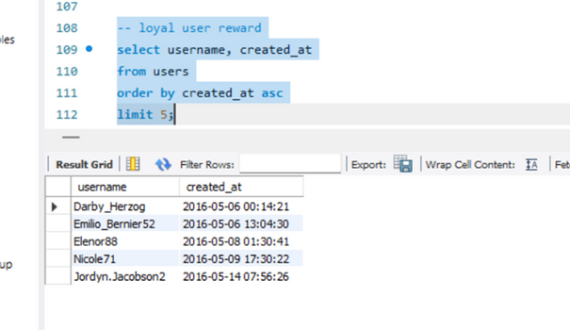
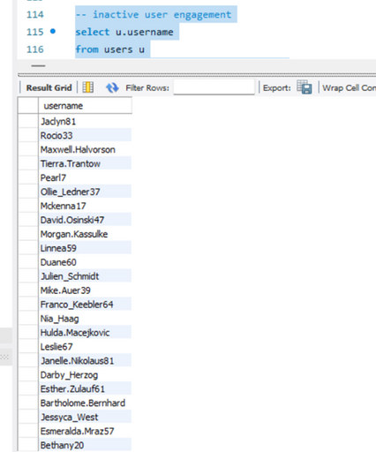
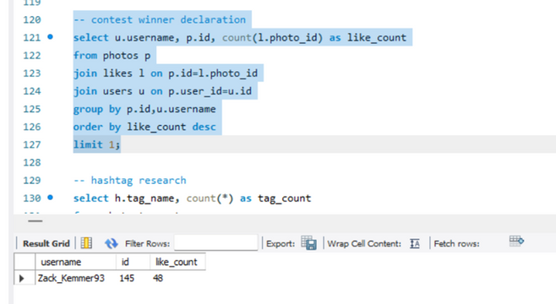

Slide 10
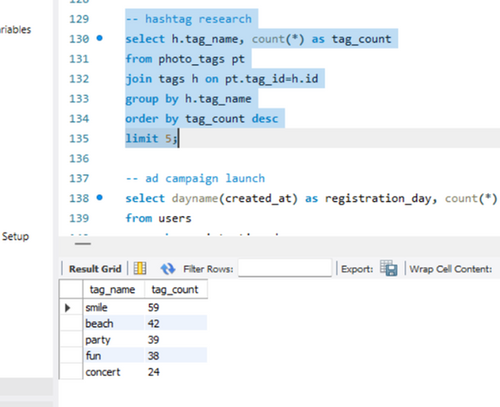
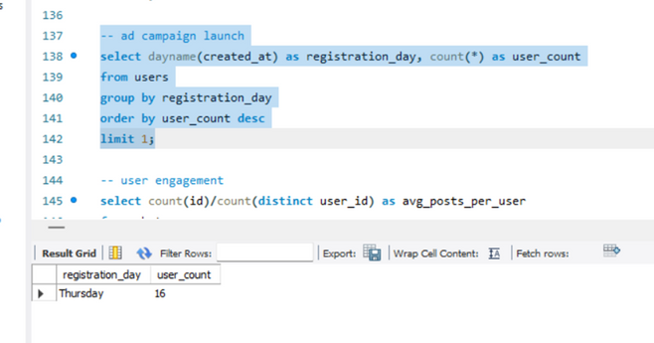
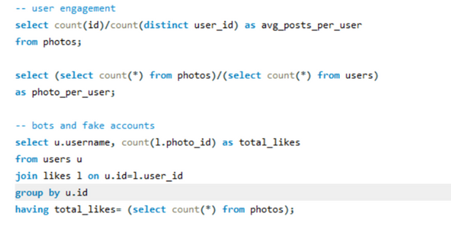
Investor Metrics

Slide 11
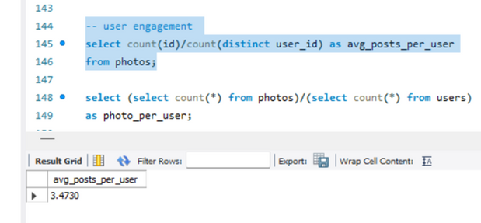
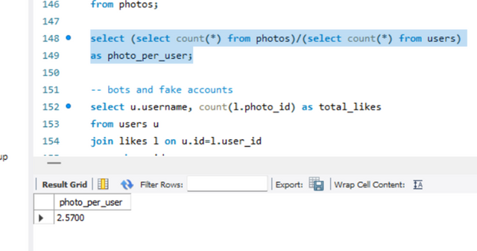
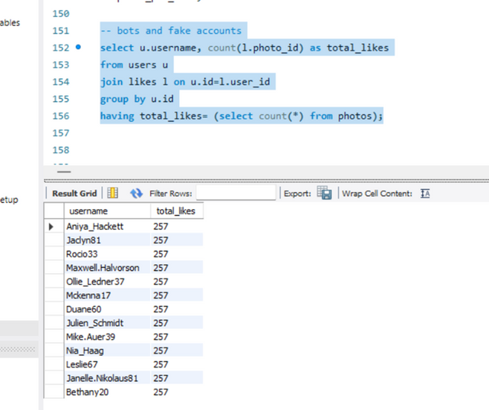

Slide 12
Insights
1. Most loyal users can be approached for rewards or brand ambassador opportunities.
2. For inactive users, targeted email campaigns should be made to encourage them to share their first post.
3. Promoting the content of contest winner for user with most likes on a single photo can inspire others to participate in similar contest.
4. Hashtag research helps partner brands align their marketing strategies.
5. Ad campaign launch analytics could help team schedule ads and running those in high-traffic days.
6. User engagement helps in taking actions regarding feature improvements and content incentives.
7. Bot accounts detection helps in tacking fake
accounts, helping authentic engagement and platform integrity.
Results
Successfully identified key user behaviours.
Provided actionable insights for marketing and product teams.
Highlighted areas of concern for investor reporting.

Slide 13
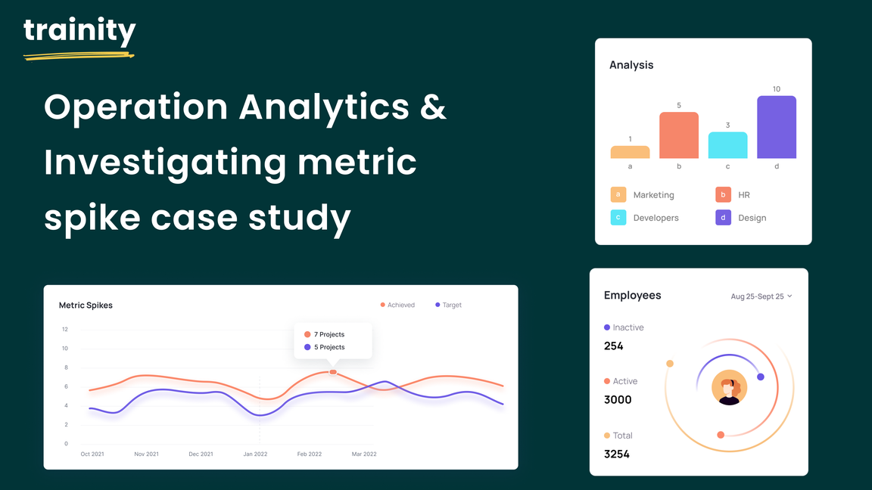
Operation Analytics with Metric Spike
Module -III
Case Study 1: Job Data Analysis
Project Description:
The project stresses on analysis of job data for insights into the job review patterns, throughput, and language share analysis.
Approach:
1. Created the table job_data with columns job_id, actor_id, event, language, time_spent, org, and ds using the database case_study1.
2. Entries are added randomly utilizing the SOL functions.
3. Executed SQL queries for each task.
4. Reviewed obtained outputs to identify patterns.
5. Drew insights and interpretations from the results.
Tech-Stack Used:
1. MySQL Workbench: For executing the SQL queries.
2. SQL: For data analysis.

Slide 14
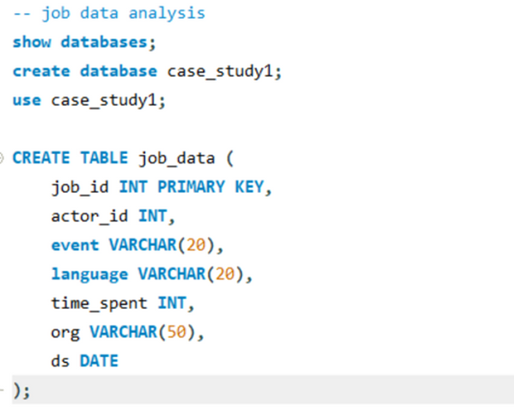
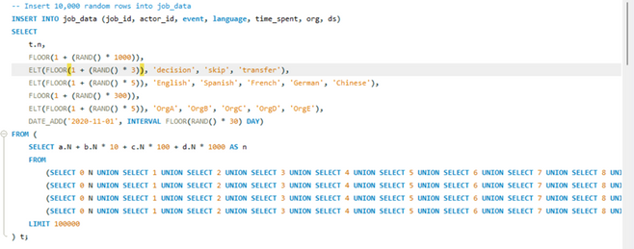
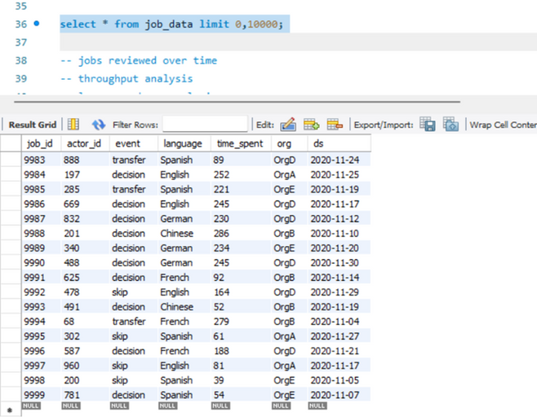
Queries and Outputs

Slide 15
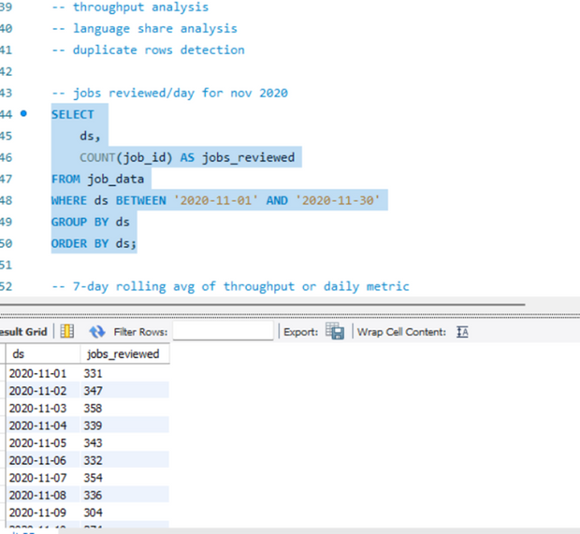
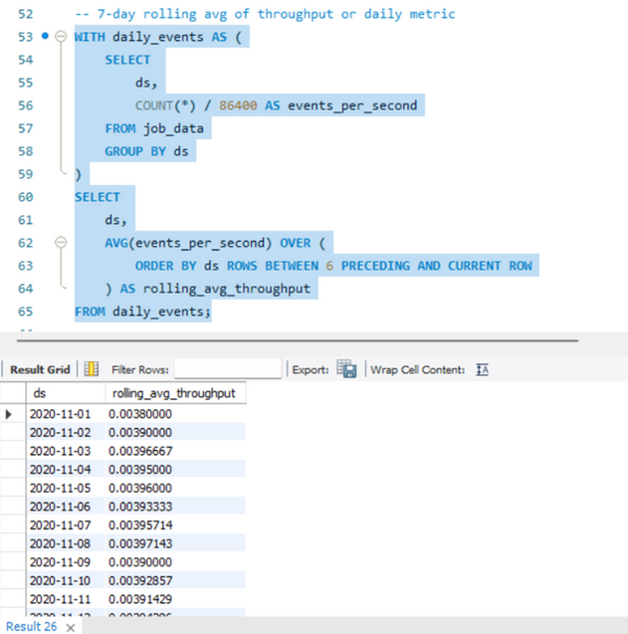

Slide 16
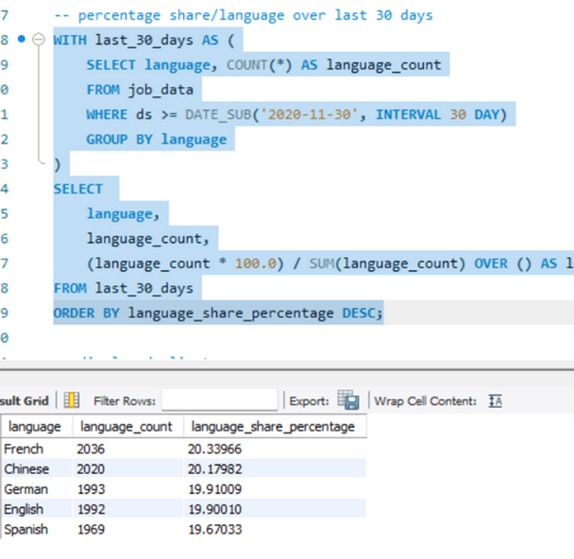
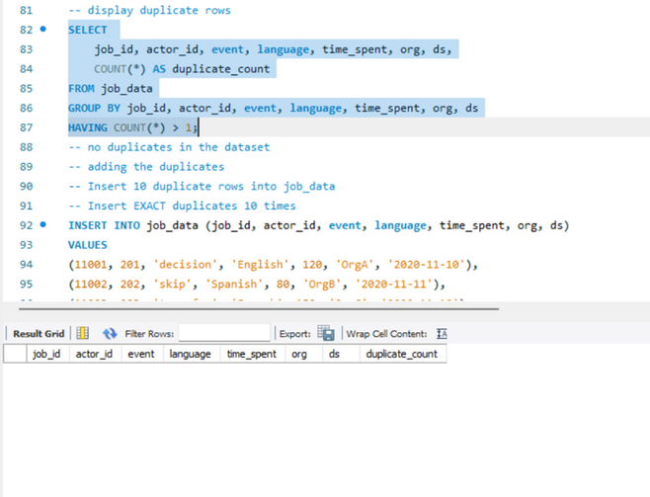
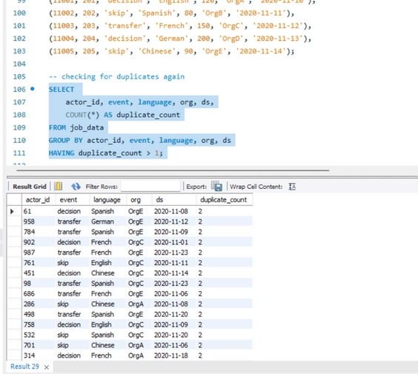

Slide 17
Insights:
1. Jobs reviewed/day: the daily review count shows job activity patterns. Spikes indicate high-priority days/ system anomalies while dips highlight holidays/outages.
2. Throughput analysis: the rolling average overcome daily fluctuations, hence providing long-term patterns. It is preferred over daily metrics for identifying consistent patterns whereas in case of spotting sudden spikes or dips, daily metric should be preferred.
3. Language share analysis: highest for French, least for Spanish.
4. Duplicate rows detection: for data inconsistency identification. There were no duplicate rows initially, so after inserting exact duplicates, checking whether the query works correctly. It did.
Results:
1. Developed and executed SQL queries for all tasks.
2. Provided insights into job review patterns, throughput trends, and language shares.
3. Validated duplicate detection with sample data.

Slide 18
Case Study 2: Investigating Metric Spike
Project description:
This project focuses on analysing user engagement, growth, retention, and email activity to identify and investigate metric spikes. The goal is to uncover meaningful insights that can guide business decisions and product improvements. SQL queries were used to extract and analyse data from three key datasets: users, events, and email_events.
Approach:
1.Data Exploration: Reviewed the structure of the three datasets:
o users: Contains user information, including signup dates.
o events: Logs user actions, including timestamps and device information.
o email_events: Tracks email interactions with columns for user actions and timestamps.
2.SQL Query Development: Constructed queries to address key metrics such as user engagement, growth, and email interaction.
3.Results Analysis: Evaluated outputs for trends, spikes, and anomalies.
4.Report Compilation: Documented queries, outputs, and insights.
Tech-stack used:
MySQL Workbench: For writing and executing SQL queries.
SQL: Structured Query Language for data analysis

Slide 19
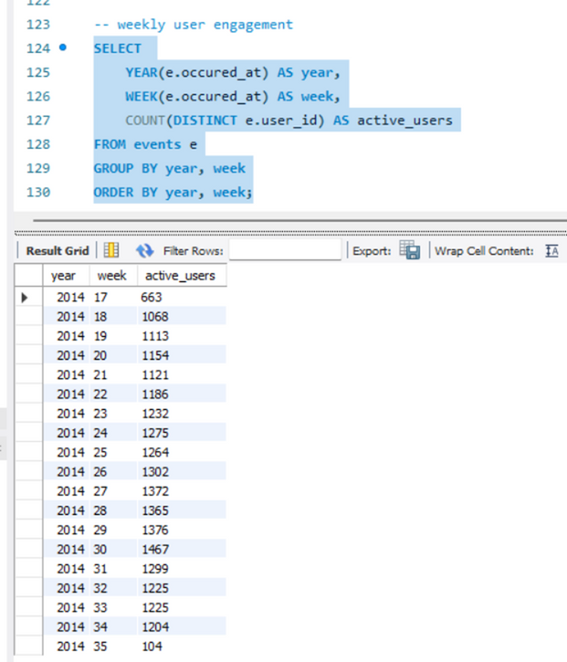
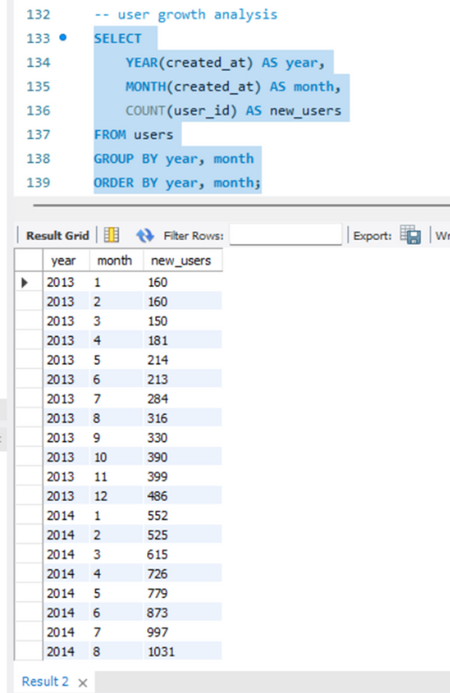
Queries and Outputs

Slide 20
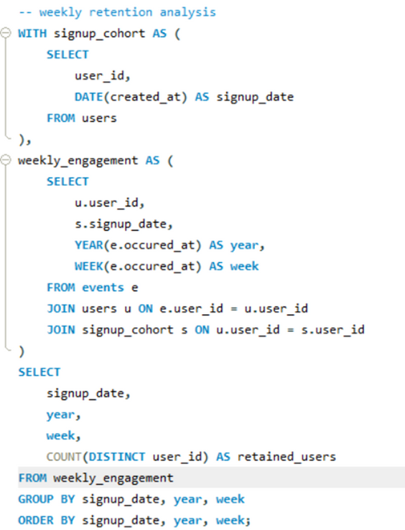
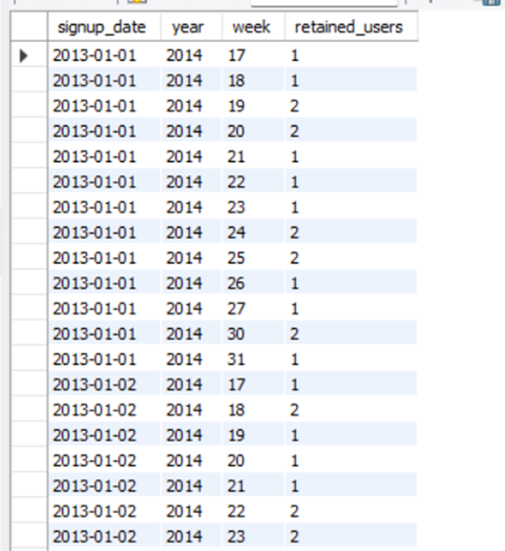

Slide 21
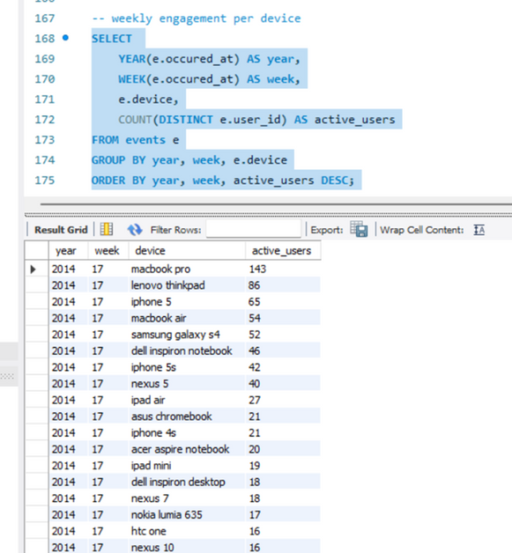
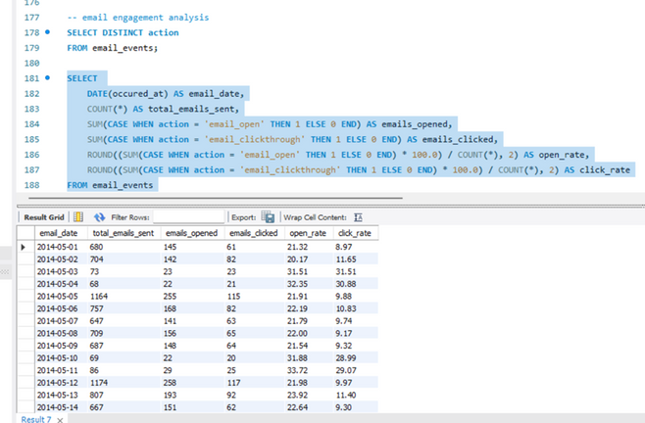

Slide 22
Insights:
1. Weekly user engagement trends highlight active user patterns. Spikes may indicate successful feature launches or marketing campaigns.
2. Growth trends show the pace at which users join the platform. Sharp increases may point to effective onboarding strategies or viral events.
3. Retention metrics help identify how well the platform retains users after sign-up. Strong weekly retention suggests user satisfaction and engagement.
4. Device-level engagement provides insights into user preferences, helping prioritize mobile or desktop experiences.
5. Tracking email action rates evaluates the effectiveness of email campaigns. Low engagement may signal the need for improved content or targeting.
Results:
Successfully executed SQL queries to investigate user engagement, growth, retention, and email activity.
Identified potential metric spikes linked to user actions and email interactions.
Delivered actionable insights for product and marketing teams.

Slide 23
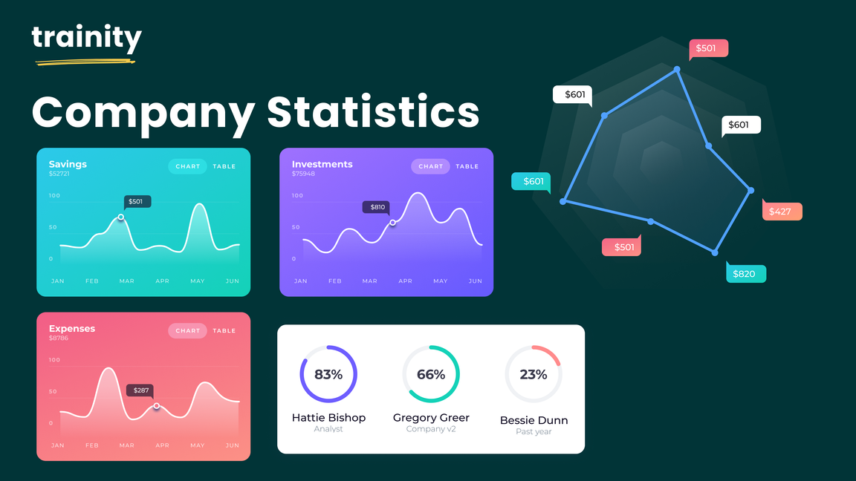
Hiring Process Analytics
Module - IV
Project Description:
This project focuses on analysing the hiring data to gain insights into the company's recruitment process. The main objectives are to explore hiring patterns, salary distributions, departmental and position tier analysis, and identify trends that can help improve future hiring strategies.
Approach:
1. Data cleaning for handling missing values and outliers.
2. Data analysis using excel to perform the tasks.
3. Data visualisation to interpret and draw the insights.
Tech-Stack Used:
Microsoft excel 2019 is used for statistical calculations, creating visualisations like bar graphs and pie charts, forming pivot tables and charts to interpret hiring data.

Slide 24
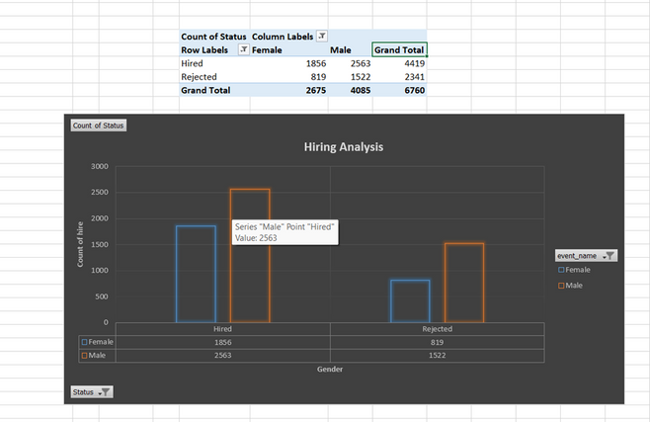
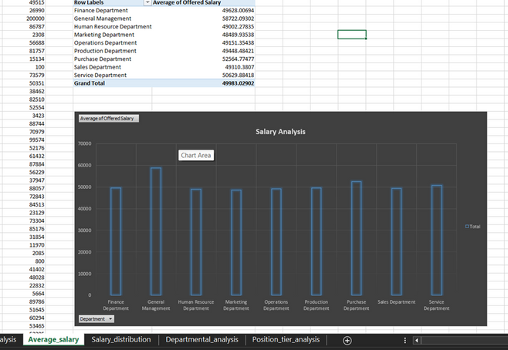
Insights:
Hiring Analysis: The gender distribution analysis revealed the proportion of male and female hires, providing a clear picture of gender representation in the company.
2. Salary Analysis: The average salary offered was calculated, and class intervals for salary distribution highlighted the spread and concentration of salaries across various ranges.

Slide 25
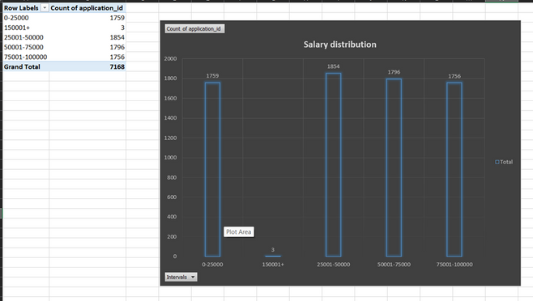
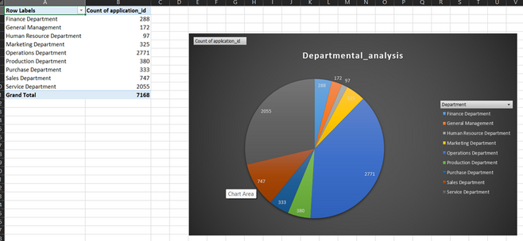
3. Salary Distribution: The salary distribution showed that most salaries fall within the 10,000–50,000 range, with fewer employees earning above 100,000. The distribution exhibited a right-skewed pattern, indicating limited high-tier positions compared to mid-level roles.
4. Departmental Analysis: Visual representations showed the distribution of employees across departments, identifying areas with higher or lower staffing.

Slide 26
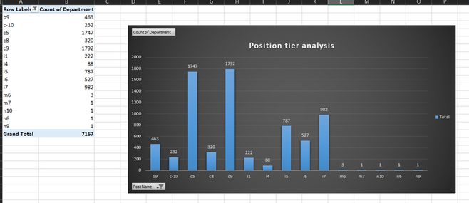
5. Position Tier Analysis: Analysed the spread of job tiers, helping to understand the distribution of roles within the organization.
Results:
Through this project, we gained a deeper understanding of the company's hiring patterns, salary distribution, and departmental composition. The insights derived can support data-driven decisions for more balanced hiring practices and salary structuring. This analysis contributes to improving recruitment strategies and identifying potential areas for optimization.

Slide 27
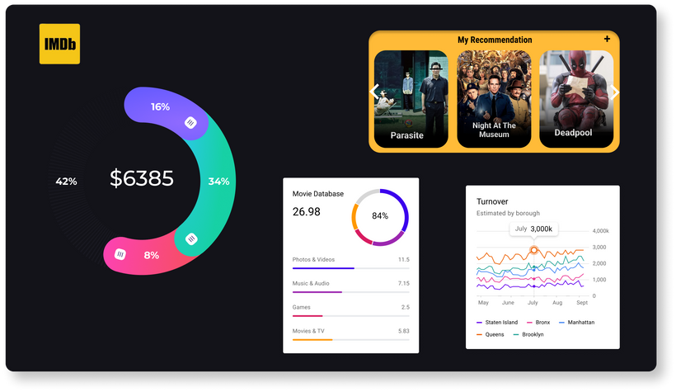
IMDb Movie Analysis
Module - V
Project Description
The IMDB Movie Analysis project aims to uncover insights about movies by analysing various factors such as genre, duration, language, director influence, and budget. The goal is to understand how these elements impact movie ratings and financial success, providing data-driven insights for filmmakers, producers, and enthusiasts.
Approach
1. Genre Analysis:
Calculated descriptive statistics (mean, median, mode) for IMDB scores across unique genres.
Used Excel functions like AVERAGE, MEDIAN, and MODE to identify trends.
Compared statistics to explore the relationship between genre and movie ratings.

Slide 28
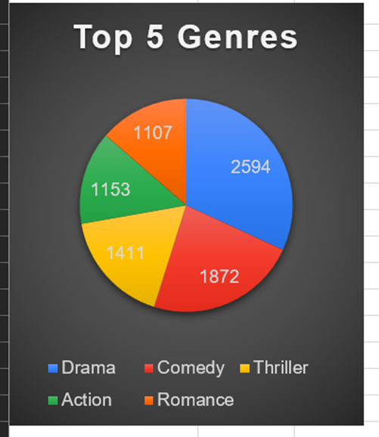
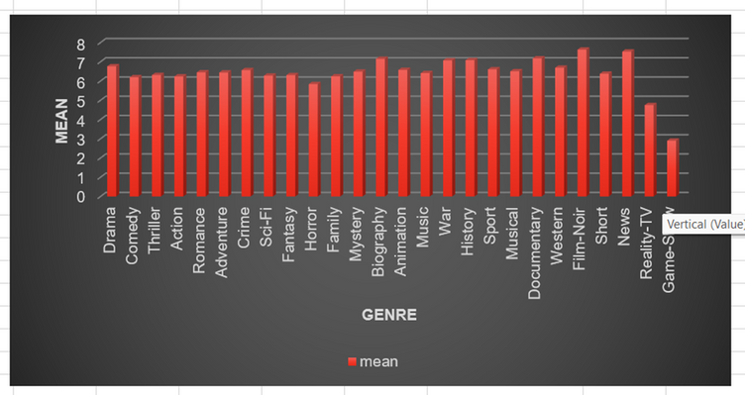

Slide 29
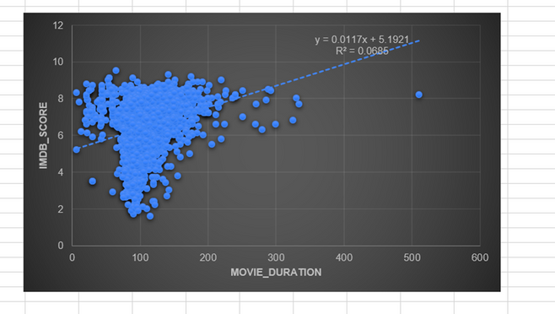
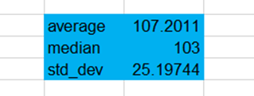
2. Duration Analysis:
Cleaned the data by removing blanks in the movie duration column.
Computed mean, median, and standard deviation for movie durations.
Created a scatter plot in Excel to visualize the relationship between movie duration and IMDB scores.
Added a trendline to assess the strength and direction of the correlation.

Slide 30
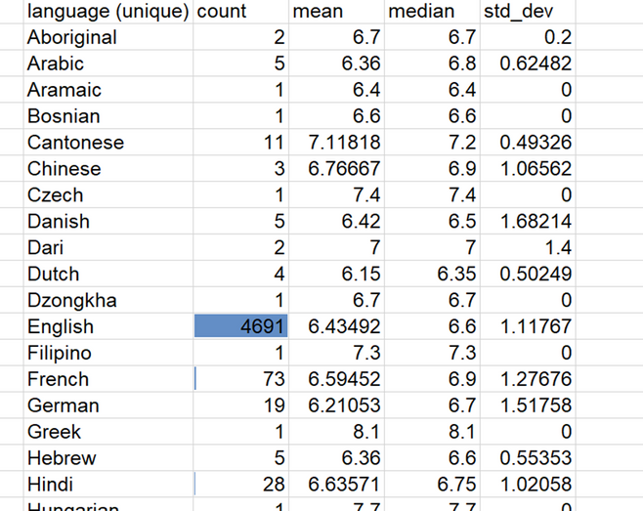
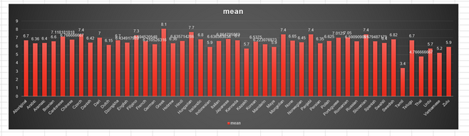
3. Language Analysis:
Created a unique language column.
Used COUNTIF to count the number of movies for each language.
Calculated mean, median, and standard deviation for IMDB scores for each language.
Compared language-wise statistics to observe their impact on ratings.

Slide 31
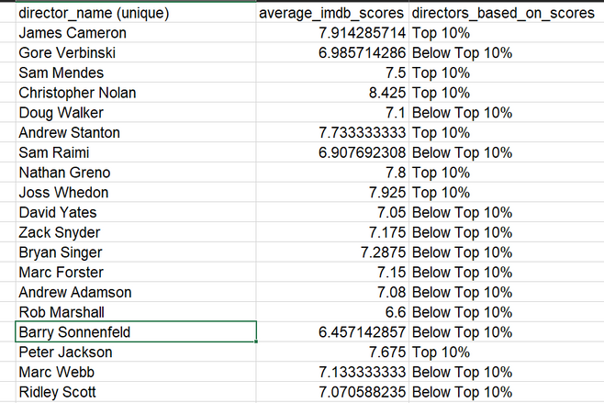
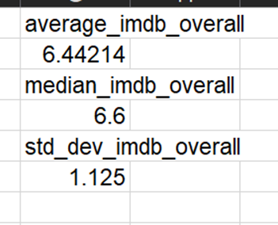
4. Director Analysis:
Generated a list of unique directors.
Computed the average IMDB score for each director using AVERAGEIF.
Applied Excel’s PERCENTILE function to identify top-performing directors.
Compared their scores against the overall IMDB score distribution

Slide 32
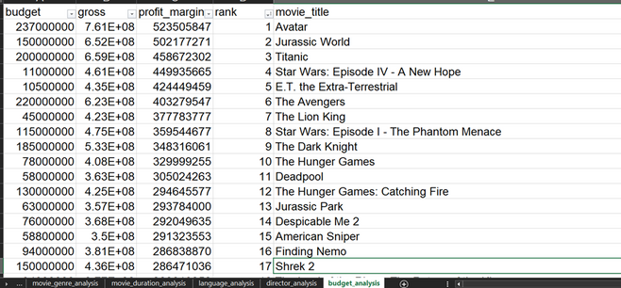
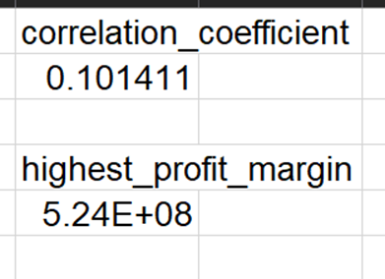
5. Budget Analysis:
Analysed the correlation between movie budgets and gross earnings using the CORREL function.
Calculated profit margins (gross earnings - budget) for each movie.
Used MAX to identify the top 10 most profitable movies

Slide 33
Tech-Stack Used
Microsoft Excel: For data cleaning, statistical analysis, visualization (scatter plots, trendlines), and correlation studies.
Functions Used: AVERAGE, MEDIAN, MODE, STDEV, COUNTIF, CORREL, MAX, PERCENTILE, AVERAGEIF.
Insights and Results
1. Genre Impact: Certain genres like Thriller and Adventure showed higher average IMDB scores, while others like Romance and Comedy had wider variability.
2. Duration Correlation: A slight positive correlation was observed between movie duration and IMDB scores — longer movies tended to have slightly better ratings.
3. Language Trends: English-dominated movies had the most entries, but other languages like French and Spanish showed promising average scores.
4. Director Influence: Top directors (as per PERCENTILE analysis) consistently produced high-rated movies, reinforcing their impact on a movie's success.
5. Budget vs. Profit: No strong correlation was found between high budgets and high ratings, but the top 10 most profitable movies had moderate budgets and massive box office earnings, emphasizing smart investments over extravagant spending.

Slide 34
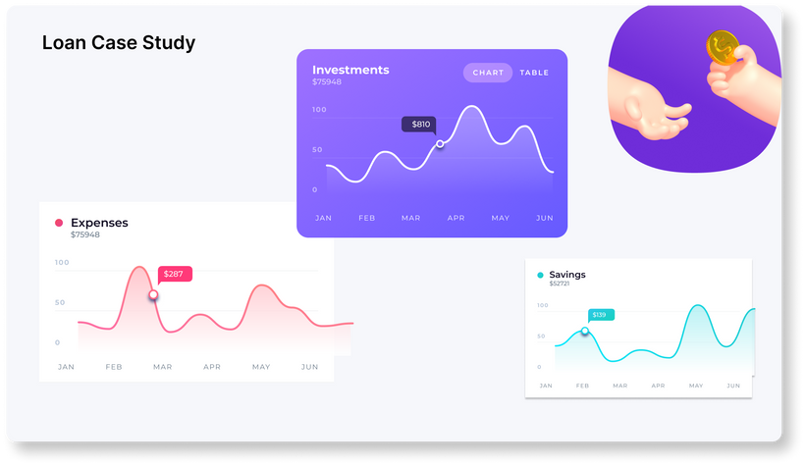
Bank Loan Case Study
Module - VI
Project Description
The Bank Loan Case Study aims to analyse loan application data to identify key factors affecting loan defaults. The study involves handling missing data, detecting outliers, analysing data imbalance, performing statistical analysis, and identifying the most significant correlations that influence loan repayment behaviour.
Approach
1. Handling Missing Data
Identified missing values using COUNTIF function.
Approach for handling missing values is explained.
Created a bar chart to visualize missing values across variables.
2. Detecting Outliers
Used QUARTILE and IQR methods to detect outliers in numerical
variables like AMT_INCOME_TOTAL, DAYS_EMPLOYED and others
Created scatter plots to visualize outlier distribution.
Removed extreme outliers whereever necessary for accurate
analysis.

Slide 35
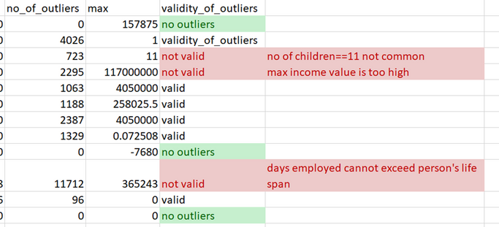
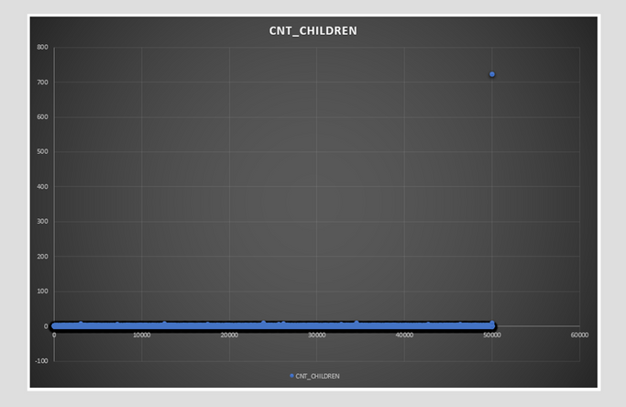

Slide 36
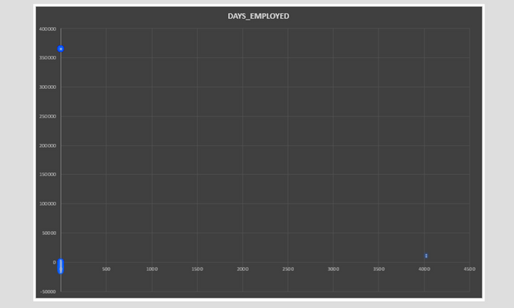


3. Data Imbalance Analysis
Checked imbalance in the TARGET variable using COUNTIF.
Calculated the proportion of TARGET = 1 (loan defaults) and
TARGET = 0 (non-defaults).
Created a pie chart to visualize data imbalance.

Slide 37



4. Univariate, Segmented Univariate, and Bivariate Analysis
Performed univariate analysis on key financial and demographic factors using AVERAGE, MEDIAN, and STDEV. Also, prepared histograms, box plots and scatter plot for different variables for visualization

Slide 38


Conducted segmented univariate analysis by calculating the descriptive statistics based on Targett variable. Created charts for visualization.

Slide 39


Performed bivariate analysis by creating a correlation matrix on major factors influencing the Target variable. Also created a scatter plot for better visualization.
5. Correlation Analysis & Key Indicators of Default
Used the CORREL function to compute correlations for each
segment.
Identified top correlated features influencing loan defaults.
Created heatmap to compare top correlations between both groups.

Slide 40

Tech Stack Used·
Microsoft Excel (Data cleaning, statistical functions, charts)
Data Visualization (Bar charts, Box plots, Scatter plots, Heatmaps)
Insights and Results
1. Missing Data: Significant missing values in some financial attributes
required imputation.
2. Outliers: Extreme outliers were detected in CNT_CHILDREN,
AMT_INCOME_TOTAL and DAYS_EMPLOYED.
3. Imbalance Analysis: The dataset was highly imbalanced, with a small
proportion of TARGET = 1 cases.
4. Loan Default Factors: Key financial indicators, such as AMT_CREDIT,
AMT_ANNUITY, and DAYS_CREDIT, showed strong correlations with loan defaults.
5. Segmented Correlations: The correlation between AMT_CREDIT and
AMT ANNUITY was stronger in defaulters, indicating potential financial distress as a predictor.

Slide 41

Car Features Analysis
Module- VII
Project Description: This project focuses on analyzing a car dataset to extract meaningful insights related to pricing, fuel efficiency, and brand performance. The goal is to understand patterns in car prices, how features like engine size and body style affect market value, and how fuel efficiency varies across models.
The dataset used contains information on over 11,900 cars, including variables like Make, Model, Year, Engine HP, Transmission Type, MSRP, Fuel Type, MPG, and more.
Approach:
The analytical approach for this project was centered entirely around Excel Pivot Tables and data visualizations. Pivot tables were used to summarize and analyze the dataset by aggregating values such as average MSRP, total MSRP, fuel efficiency, and other metrics across various categories like car brand, body style, transmission type, and model year. This method allowed for dynamic data exploration and quick extraction of meaningful patterns without the need for complex formulas or additional functions.
We utilized a variety of chart types—such as stacked column charts, clustered column charts, scatter plots, and line graphs—to visualize relationships and trends in the data. Each chart was made interactive using slicers and filters, enabling users to drill down into specific aspects of the dataset easily. The combination of pivot tables and interactive charts formed the core analytical technique throughout the project, providing a user-friendly way to answer business questions and generate actionable insights.

Slide 42


Tech stack used:
Microsoft Excel for the entire workflow: data cleaning, pivot tables, and visualization which provides:
1. Highly accessible and widely used.
2. Offers dynamic features like slicers, filters, and interactive dashboards. Excel's Data Analysis Toolpak for correlation coefficient.
Insights and Results:
Above figure shows the relationship between different market categories with that of popularity of the model and the count of model. Popularity peaks for diesel market category whereas highest count of model turns out to be unknown followed by luxury market category.

Slide 43

Above figure shows the scatter plot between engine power and MSRP (price). Relationship is found to be linearly increasing.
The above figure shows the regression statistics.
Multiple R value suggests a moderate positive relationship between predictors and target. Adjusted R square close to R square indicates a good number of relevant predictors. Standard error indicates error in predictions.
Observations refer to sample size which in this case is a solid amount.
Model’s p-value comes out to be near zero from further analysis, which is highly significant and f-score turns out to be very high, indicating overall regression model is statistically significant.
The only insignificant predictor: city MPG.

Slide 44


The figure below shows the relationship between highway mpg with engine cylinders which turns out to be linearly decreasing, i.e. inversely proportional. The correlation coefficient is close to -1 suggesting the same.
The figure above shows average of MSRP based on the brand (make). Highest price goes to the Bugatti model.

Slide 45

ABC Call Volume Trend Analysis
Module - VIII
Project Description: This project focuses on Customer Experience (CX) analytics for ABC Insurance Company, specifically analyzing inbound call data spanning 23 days. The goal is to derive insights that help optimize call handling, improve customer satisfaction, and support strategic manpower planning. Key call-related metrics such as duration, volume, and abandon rate were analyzed across different time buckets.
Approach: We performed an in-depth data analysis using Microsoft Excel to clean and structure the dataset. Calculations and visualizations were developed to determine average call durations, call volumes by time bucket, and agent requirements to reduce the abandon rate. We applied time-based aggregation, pivot tables, bar charts, and manpower efficiency assumptions to generate actionable insights and forecasts.
Tech Stack Used: Microsoft Excel: Used for time-series analysis, statistical calculations, and data visualization.

Slide 46


Insights:
Average Call Duration: Average duration was calculated for each time bucket (e.g., 9-10 am, 10-11 am, etc.). Higher average durations were noted in mid-morning and late afternoon slots, indicating possible complexity in customer queries during those periods.
2. Call Volume Analysis: A time-bucketed bar chart showed peak call volumes between 10 am to 12 pm and again from 9 pm to 10 pm. These peaks suggest the need for focused manpower allocation during these hours.

Slide 47


3. Manpower Planning: Based on the existing 30% abandon rate and target of 10%, the number of agents per time bucket was recalculated. The number of agents was proportionally scaled to ensure at least 90 out of 100 calls are answered during peak hours.

Slide 48


4. Night Shift Planning: Assuming night calls are 30% of day calls, the call distribution was modeled across 9 pm to 9 am in hourly buckets. A manpower plan was proposed for night shifts to meet the same 10% maximum abandon rate, considering operational constraints.

Slide 49
Results: The project resulted in a detailed hourly manpower allocation plan aimed at reducing call abandon rates to 10% during both day and night operations. The analysis also revealed high-demand periods, enabling more efficient resource scheduling. This contributes to improved customer satisfaction and operational efficiency for ABC Insurance Company's inbound support team.
Thank You
GiHub: https://github.com/sneha054
LinkedIn: www.linkedin.com/in/sneha-katole
Gmail: snehakatole02@gmail.com

